Slide 1
DRIVER DROWSINESS DETECTION
TEAM NUMBER:3
TEAM MEMBERS:
HARISH KRISHNA-19BCS064
LAKSHYA JAIN-19BCS068
SIBI-19BCS070
HISHAM AHMED-19BCS071
DOMAIN:DEEP LEARNING

Slide 2
PROBLEM DEFINITION
Driver drowsiness detection is a car safety technology which helps to prevent accidents caused by the driver getting drowsy while driving.
One of the most important factors in accidents is that the driver is fatigue and monotony. Fatigue reduces driver perceptions and decision making capability to control the vehicle.
Various studies shows that around 20% of all road accidents are fatigue-related.
By monitoring the eyes , driver’s fatigue can be detected to avoid a car accident. Detection of fatigue involves the observation of eye movements and blink patterns in a sequence of images of a face.

Slide 3
Abstract
Drowsiness while driving is a highly prevalent problem that leads to thousands of fatal accidents every year. So we are developing a system to provide solution for detecting drowsiness .
This Drowsy Driver Detection system is designed by DeepLearning techniques using Python and OpenCV.
In simple words, it maps the coordinates of the facial landmarks of the input video and drowsiness is detected by monitoring eyes .

Slide 4
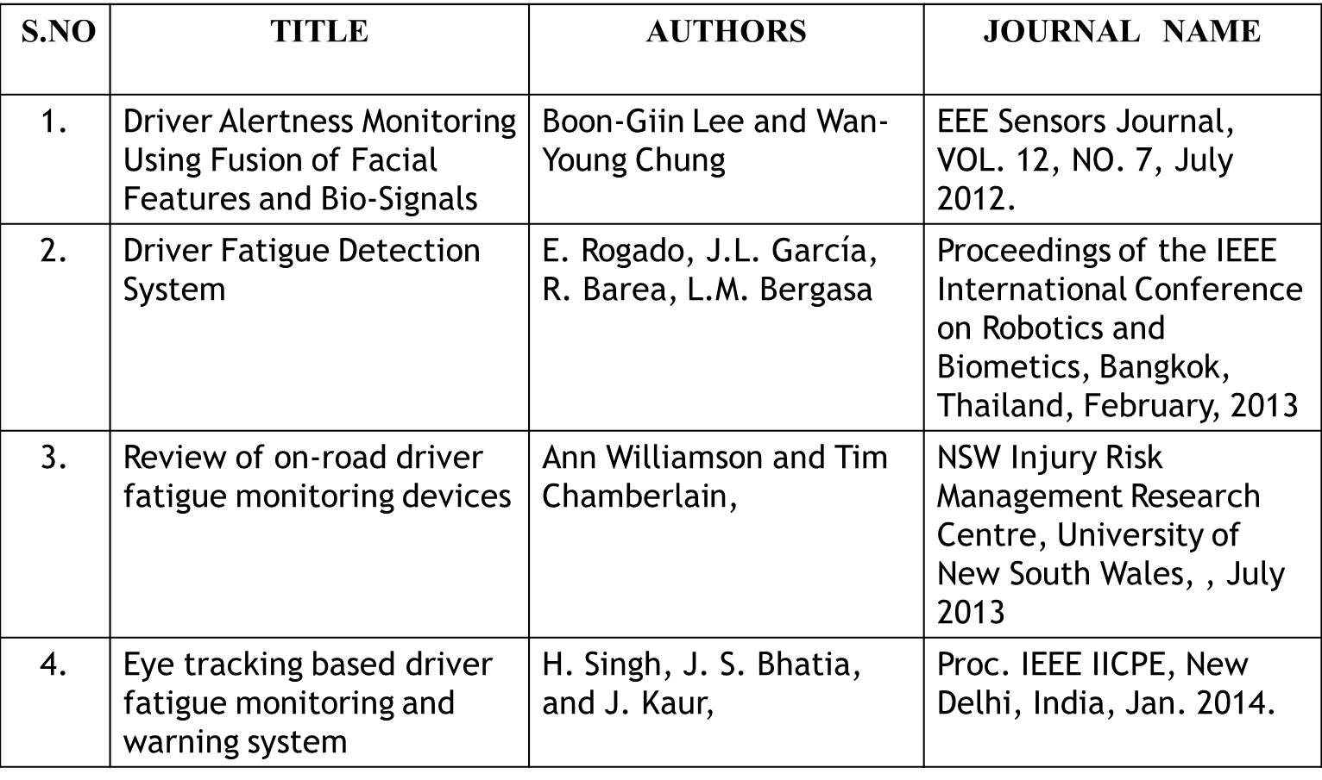
LITERATURE SURVEY

Slide 5
LITERATURE SURVEY
Ijcstjournal.org - volume 3 For detailed information on the literature survey
Issue 4 available on Ijcstjournal.org
https://ieeexplore.ieee.org/document/9204306.
These are some of the links to get detailed information why we chose the project.

Slide 6
Limiting Factors of Existing System
Existing systems are made of eye blink sensors, it works by illuminating infrared light to monitor changes of the eyes.
Prolonged exposure to such IR , causes damage to retina and may also cause swelling
The existing systems are dependent on the datasets which will be a slow process.
The dataset occupies heavy storage so it’s a waste of storage and performance of the pc will be affected.

Slide 7
PROPOSED SYSTEM
The system will alert when the driving person is feeling drowsy or yawning.
It is pretty much faster than other existing systems.
The system will see the ratio in each frame by comparing the real time sequence and alerts when the ratio is very less.
There will be no alerts for blinking or winking.
The system will alert only if eyes are closed in all frames which will be approximately 6-7 seconds in real-time sequence.

Slide 8
Features of Contemporary System
Our system can be used with normal pc camera or external camera.
There is no datasets involved in this system and so the process will be very quick compared to the dataset systems.
The detection will be done using an aspect ratio which will be compared with real time sequence .
The ratio values will be mentioned in the code and it will be exiting if its not in a specific range of ratio.

Slide 9
Technology Stack
HARDWARE REQUIREMENT
Operating System: Windows 10
Language Used: Python,OpenCV(package)
Browser: Google Chrome, Mozilla Firefox
Software & IDE:Pycharm
SOFTWARE REQUIREMENT:
Processor: i3 processor and above
RAM: 4GB or more
Hard disk: 20GB or more
Internet Bandwidth : Atleast 5 Mbps
Webcamera(optional)

Slide 10
Reference
https://www.youtube.com/watch?v=Q23K7G1gJgY
https://www.pantechsolutions.net/driver-drowsiness-detection-using-opencv-and-python
https://www.pyimagesearch.com/
https://ieeexplore.ieee.org/abstract/document/5548039

